Slide 1
[Organisation] · PHASE C
Data Lifecycle
Six stages, 24 entities, and the stage that does not happen anywhere
Create 18 · Validate 8 · Use 17 · Maintain 11 · Archive 5 · Dispose 0
Systems of record, consumers and the analytical estate
0.1 — Draft · June 2027

Slide 2
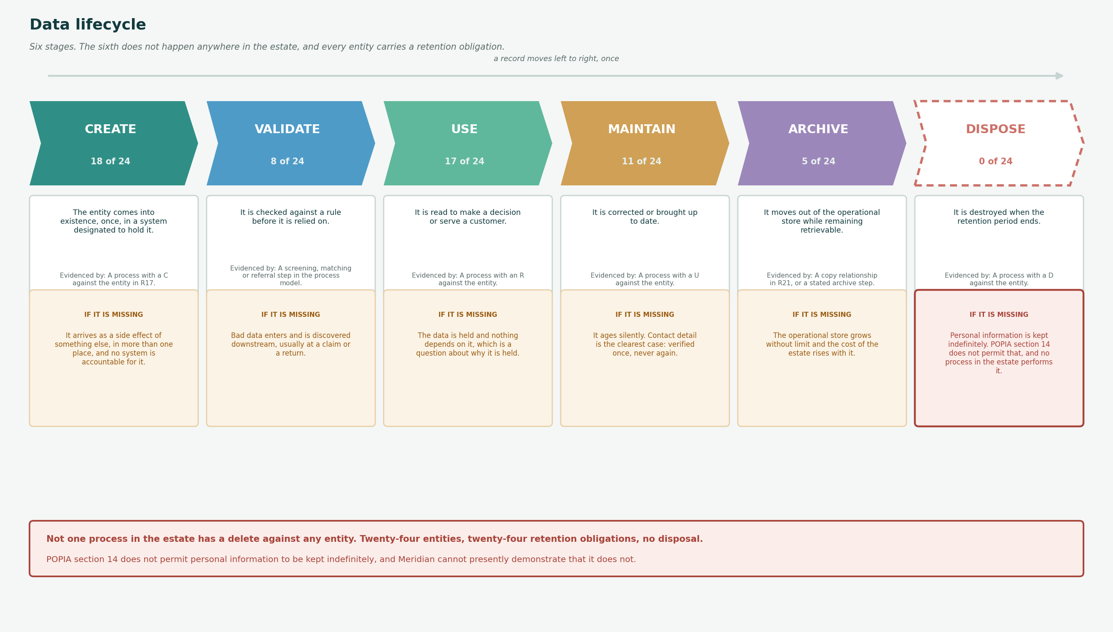
LIFECYCLE
Six stages, and the one that does not happen
Stage coverage is derived from the process-to-entity relation. Dispose is dashed because no process performs it.

Slide 3
STAGES
The six stages
What happens at each, how it is evidenced in the model, and what goes wrong when it is absent.
Create
18 of 24
The entity comes into existence, once, in a system designated to hold it.
It arrives as a side effect of something else, in more than one place, and no system is accountable for it.
Validate
8 of 24
It is checked against a rule before it is relied on.
Bad data enters and is discovered downstream, usually at a claim or a return.
Use
17 of 24
It is read to make a decision or serve a customer.
The data is held and nothing depends on it, which is a question about why it is held.
Maintain
11 of 24
It is corrected or brought up to date.
It ages silently. Contact detail is the clearest case: verified once, never again.
Archive
5 of 24
It moves out of the operational store while remaining retrievable.
The operational store grows without limit and the cost of the estate rises with it.
Dispose
0 of 24
It is destroyed when the retention period ends.
Personal information is kept indefinitely. POPIA section 14 does not permit that, and no process in the estate performs it.
Archive shows five, and all five are analytical copies rather than archives. A copy for reporting does not take anything out of the operational store.

Slide 4
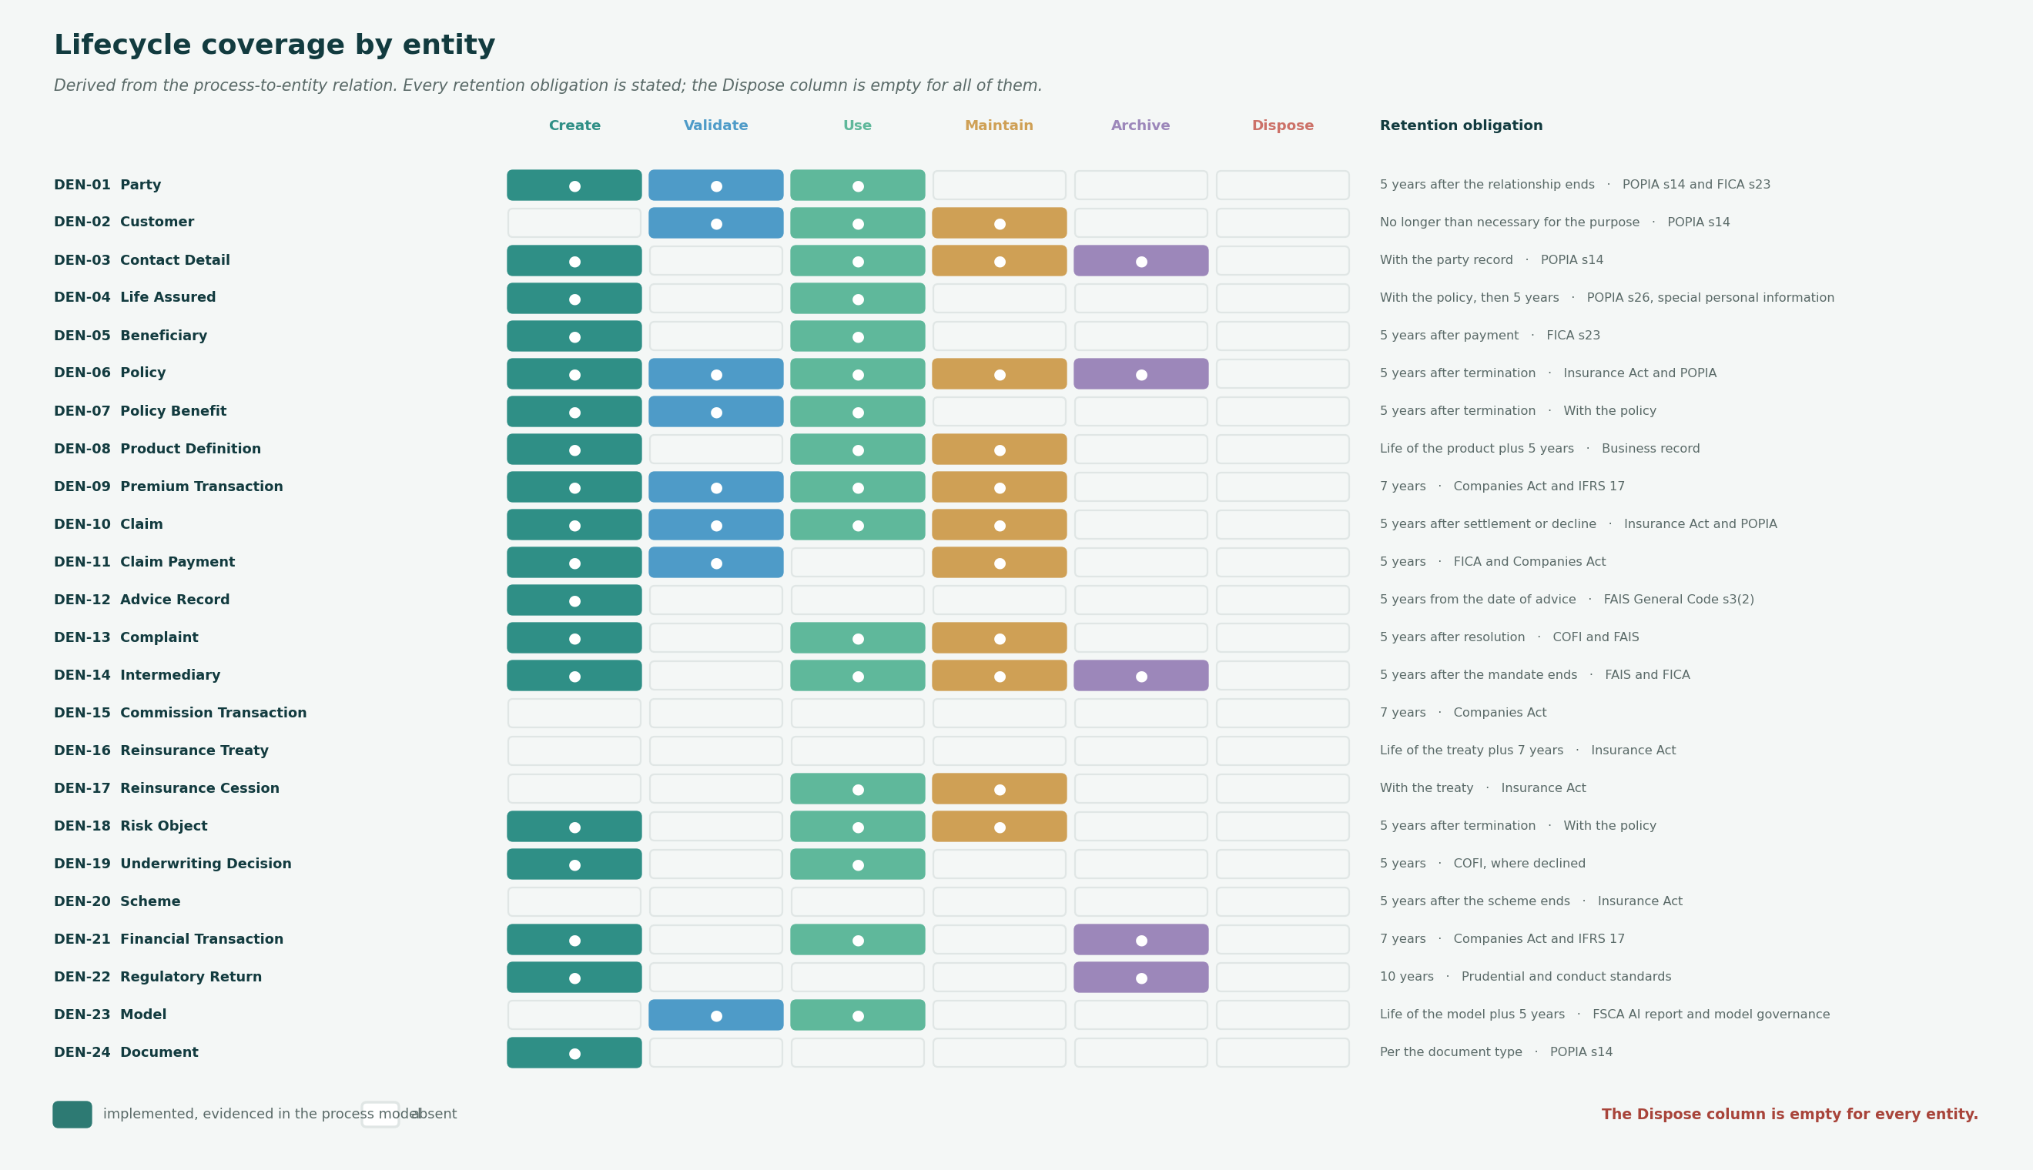
COVERAGE
Every entity, every stage
Retention obligations are stated for all 24 entities. The metamodel holds none of them.

Slide 5
WORKED EXAMPLE
What happens to a party record
One entity, six stages, and what each looks like in the estate today.
Create
Partly
A party record is created at lead capture, in whichever channel master the adviser is using. Four masters can each create one.
Four creation points, no shared identifier, and roughly 640,000 records that cannot be matched.
Validate
Partly
FICA screening runs at onboarding and is automated. Identity matching across masters does not run at all.
Screening is the best-performing service in the catalogue. Matching happens at reporting time, downstream of every process that needed it.
Use
Yes
Read by servicing, claims, compliance and reporting, 2.9 million servicing requests a year.
An agent opens 2.6 systems per request because the read has to be assembled from four places.
Maintain
Partly
Contact detail is updated on request. The verified date attribute exists and is not enforced.
A change of address is applied up to four times and confirmed three times.
Archive
No
No archive step is modelled. The four masters hold every party record ever created.
2.6 million party records against 1.9 million policies. Some of the difference is dormant records nobody has retired.
Dispose
No
Nothing deletes a party record. No process has a D against it.
POPIA section 14 requires that personal information is not kept longer than necessary. [Organisation] cannot demonstrate that it complies, because nothing in the estate disposes of anything.
Two of the six stages do not happen at all. Both are the ones that would reduce what [Organisation] holds.

Slide 6
APPLICATION MATRIX
Which application masters each entity
Master is the system of record. There should be exactly one per entity; ten have more than one.
Ref
Entity
System of record
Cont.
Consumer copies
Data sets
In R21?
DEN-01
Party
LIFE/400, PolicyHub-ST, SchemeAdmin, BancaBridge, CustomerHub
●
—
DS-01, DS-09
no
DEN-02
Customer
LIFE/400, PolicyHub-ST, SchemeAdmin, BancaBridge, CustomerHub
●
—
DS-01, DS-05
no
DEN-03
Contact Detail
LIFE/400, PolicyHub-ST, CustomerHub
●
CRM-Agent
DS-01
no
DEN-04
Life Assured
LIFE/400
—
—
DEN-05
Beneficiary
LIFE/400
—
DS-09
no
DEN-06
Policy
LIFE/400, PolicyHub-ST, SchemeAdmin
Enterprise Data Platform
8 data sets
DEN-07
Policy Benefit
LIFE/400, PolicyHub-ST
—
DS-03
no
DEN-08
Product Definition
LIFE/400, PolicyHub-ST, ProductStudio
—
—
DEN-09
Premium Transaction
PayCollect
—
DS-03, DS-05
no
DEN-10
Claim
ClaimsOne, MotorClaims
—
5 data sets
no
DEN-11
Claim Payment
FinERP
—
DS-03, DS-04
no
DEN-12
Advice Record
CRM-Agent, BrokerNet, WebQuote
●
—
DS-01, DS-02, DS-06
no
DEN-13
Complaint
CRM-Agent
—
DS-01, DS-02
no
DEN-14
Intermediary
BrokerNet
HR-Core
DS-05, DS-06, DS-09
no
DEN-15
Commission Transaction
PayCollect
—
DS-06
no
DEN-16
Reinsurance Treaty
ReinsureMgr
—
—
DEN-17
Reinsurance Cession
ReinsureMgr
—
DS-04
no
DEN-18
Risk Object
LIFE/400, PolicyHub-ST
—
DS-04, DS-08
no
DEN-19
Underwriting Decision
LIFE/400, PolicyHub-ST
—
DS-02, DS-08
no
DEN-20
Scheme
SchemeAdmin
—
—
DEN-21
Financial Transaction
FinERP
Enterprise Data Platform
DS-03, DS-07
DEN-22
Regulatory Return
IFRS17-SL
LegacyReporting
DS-07
DEN-23
Model
ModelOps
—
DS-08
no
DEN-24
Document
DocGen
—
—
A dot in the Cont. column marks a contested system of record. Orange in the last column means the analytical estate uses it and R21 does not record that.

Slide 7
THE ANALYTICAL ESTATE
The data warehouse is under-recorded
The platform is recorded against three entities. The nine data sets built on it draw on nineteen.
3
19
16
5
entities recorded against the
platform in R21
entities the nine data sets
actually draw on
entities the relation
does not record
copy relationships in the whole
estate, three of them analytical
What is recorded
Policy, Financial Transaction and Regulatory Return. Three analytical copies against a platform that serves the whole business.
Why it matters
The Archive stage in the lifecycle is derived from this relation. It reports five because the relation describes three, not because the estate archives five.
What it prevents
No lineage question can be answered from the repository. IFRS 17 and COFI both ask for lineage, and the assembly is manual because of it.
What to do
Record the platform's actual footprint in R21, entity by entity, before the lakehouse is built. Nineteen relationships, not three.
The warehouse is not missing from the estate. It is missing from the model, which is the harder problem to see.

Slide 8
FINDINGS
What the lifecycle shows
The data warehouse is recorded against three entities and draws on nineteen
APP-22 Enterprise Data Platform has three relationships in R21: Policy, Financial Transaction and Regulatory Return. The nine data sets built on it draw on nineteen entities.
The analytical estate is under-recorded by sixteen entities. That is why the Archive stage shows five: the relation the lifecycle derives from does not describe what the platform actually holds. Until it does, no lineage question can be answered from the repository, and lineage is the thing IFRS 17 and COFI both ask for.
The dispose stage does not exist anywhere in the estate
Across 24 entities and 22 processes there is not one delete operation. Every one of the 24 entities carries a retention obligation.
This is not a modelling omission that can be corrected by adding a step to a diagram. Nothing in the estate disposes of anything, and POPIA section 14 does not permit personal information to be kept indefinitely. It is the largest regulatory exposure the data architecture has surfaced.
The archive stage is barely modelled either
Five copy relationships exist in R21, all of them analytical marts rather than archives.
A copy for reporting is not an archive. The operational stores hold everything ever written, which is why the four customer masters hold 2.6 million party records against 1.9 million policies.
Three entities have no lifecycle at all
Commission Transaction, Reinsurance Treaty and Scheme have no process access of any kind.
They are created somewhere, used by someone and retained under the Companies Act and the Insurance Act. The lifecycle is happening; the model does not describe it.
Two entities are used without being created
Customer and Reinsurance Cession are read and updated by processes and created by none.
An entity that is maintained but never created came into existence outside the modelled estate. For Customer that is the identity problem; for Cession it is reinsurance being run on a spreadsheet.
Adding a retention attribute to the Data Entity type is a small metamodel change with a direct compliance consequence.

